Slide 1
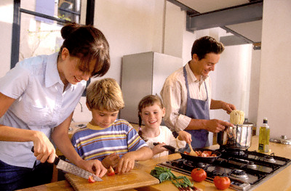
Healthy Eating Patterns
“Build a Healthy Plate”

Slide 2
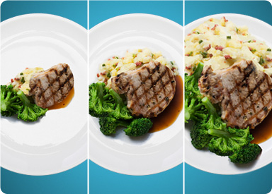
Balance Calories
Enjoy your food, but eat less.
Avoid oversized portions.
Notes:
Find out how many calories YOU need per day to manage weight.
Take the time to fully enjoy your food and pay attention to hunger and fullness cues.
Use a smaller plate, bowl and glass.

Slide 3
2. Foods to Increase:
Make half your plate fruits and vegetables.
Switch to fat-free or low-fat milk.
Make at least half your grains whole grains.
Notes:
Make the following the basis for meals and snacks:
Choose red, orange and dark green vegetables.
Add fruit as part of the meal, side dish or dessert.
Low-Fat and fat-free options provide the same amount of calcium and other nutrients, but with fewer calories and less saturated fat.
Substitute whole grains for refined products. Examples: Use wheat bread instead of white bread; brown rice instead of white rice.

Slide 4
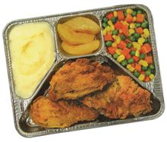
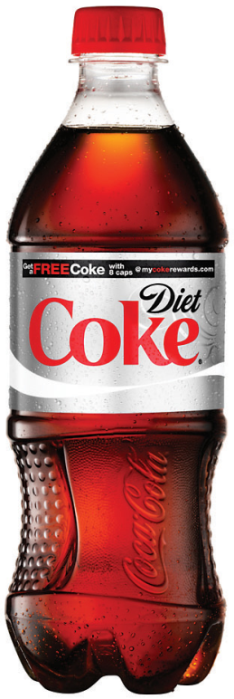
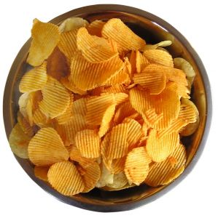
3. Foods to Reduce:
Compare sodium in foods like soup, bread and frozen meals, and choose foods with the lower numbers.
Drink water instead of sugary drinks.
Notes:
Cut back on foods high in solid fats, added sugar and salt. Use these foods as occasional treats, not as “everyday” foods.
Select low or reduced sodium or no-salt food items.
Soda, energy drinks and sports drinks are a major source of added sugar and calories in the American diet.

Slide 5
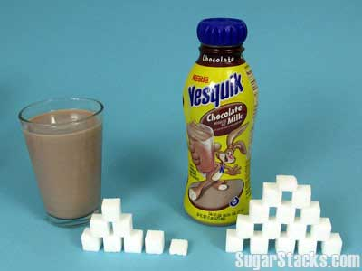
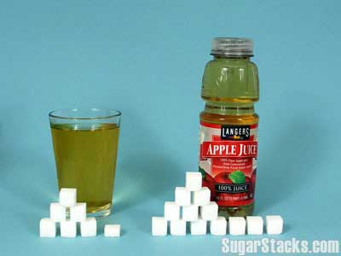
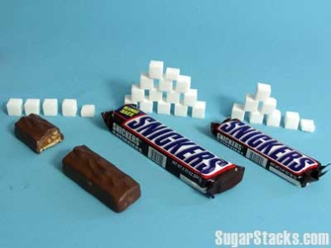
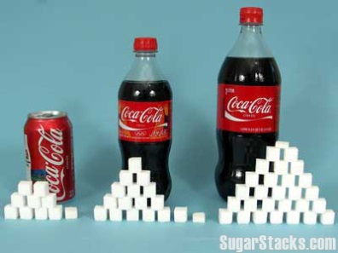
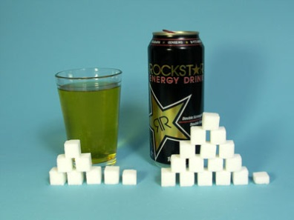
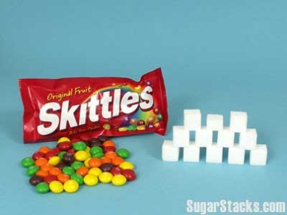
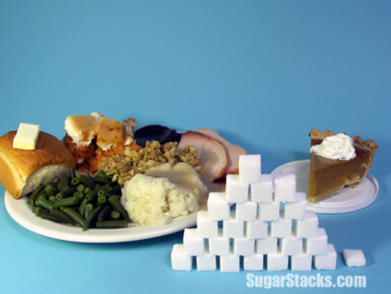
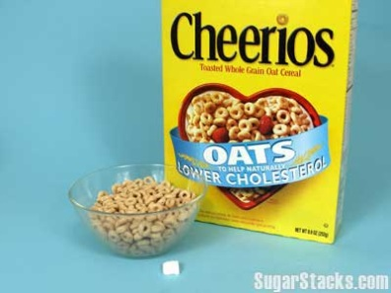
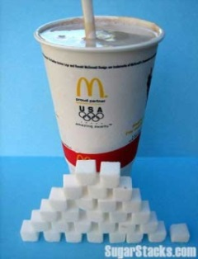
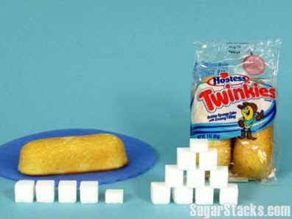
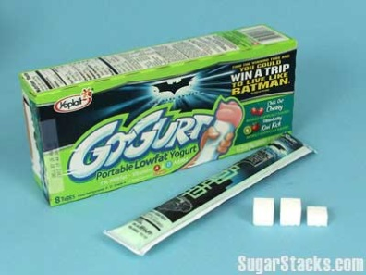
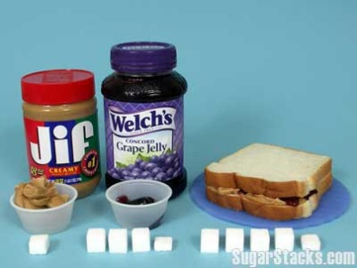
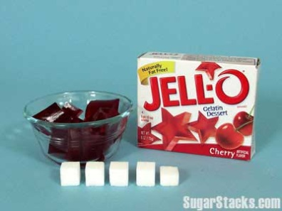
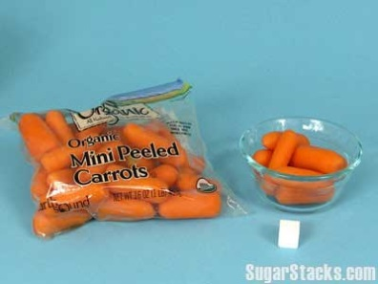
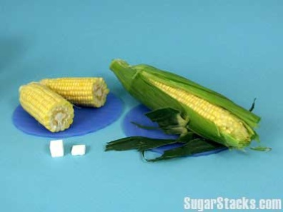
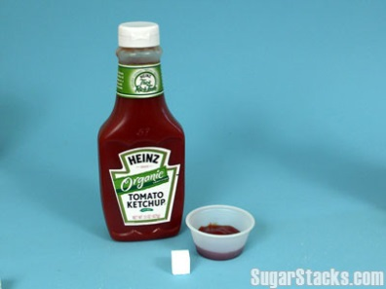
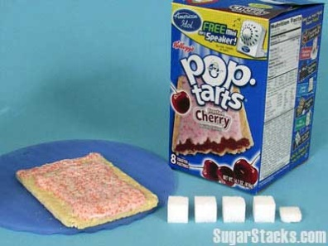

Slide 6
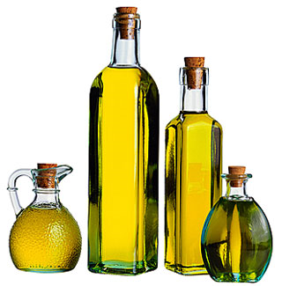
Oils
Oils are not a food group, but they do provide essential nutrients.
Choose oils that provide healthy fats.
Boys 9-13 | 5 tsp. daily
Boys 14-18 | 6 tsp. daily
Girls 9-18 | 5 tsp. daily
Notes:
Oils from plant sources don’t contain any cholesterol. They are a healthier fat source.
Examples:
Polyunsaturated Fats Food Source:
Most Vegetable Oils, Corn Oil, Soybean Oil, Safflower Oil
Monounsaturated Fats Food Sources:
Olives, Olive Oil, Avocados, Peanuts, Peanut Oil, Canola Oil
*The serving amounts indicated on the chart above are appropriate for individuals who get less than 30 minutes per day of moderate physical exercise beyond normal daily activities. Those who are more physically active may be able to consumer more while staying within calorie needs.

Slide 7
Individual Caloric Needs
Each person’s caloric needs depends on age, gender and activity level.
Gender & Age | Daily Caloric Needs | Daily Limit for Empty Calories
Boys 9-13 | 1,800 | 160
Boys 14-18 | 2,200 | 265
Girls 9-13 | 1,600 | 120
Girls 14-18 | 1,800 | 160

Slide 8
Empty Calories
Foods that have solid fats and added sugars add calories to food, but few or no nutrients.
In some foods, like candies and sodas, ALL the calories are empty calories.
A small amount of empty calories are okay, but most people eat far more than what is healthy.
Gender & Age | Daily Caloric Needs | Daily Limit for Empty Calories
Boys 9-13 | 1,800 | 160
Boys 14-18 | 2,200 | 265
Girls 9-13 | 1,600 | 120
Girls 14-18 | 1,800 | 160

