Slide 1
Heredity
An introduction to Genetics

Slide 2
What are Genes?
Genes are inherited traits
Physical characteristics passed on to children contributed by both parents.
There are 23 pairs of chromosomes in a fertilized cell- for a total of 46 chromosomes. - contained in the nucleus

Slide 3
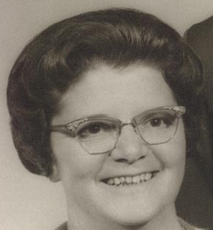
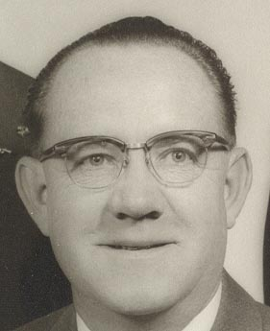
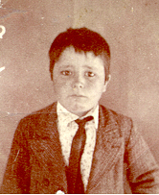
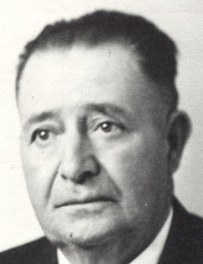
Parents
Children
b
1
2
a
d
3
4
c

Slide 4
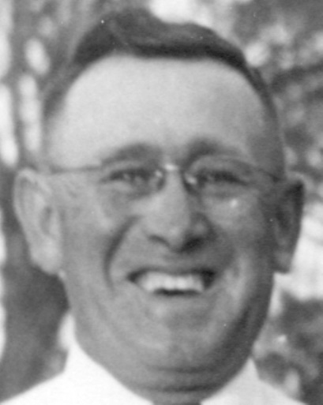
a
b
4
3
c
1
d
2

Slide 5
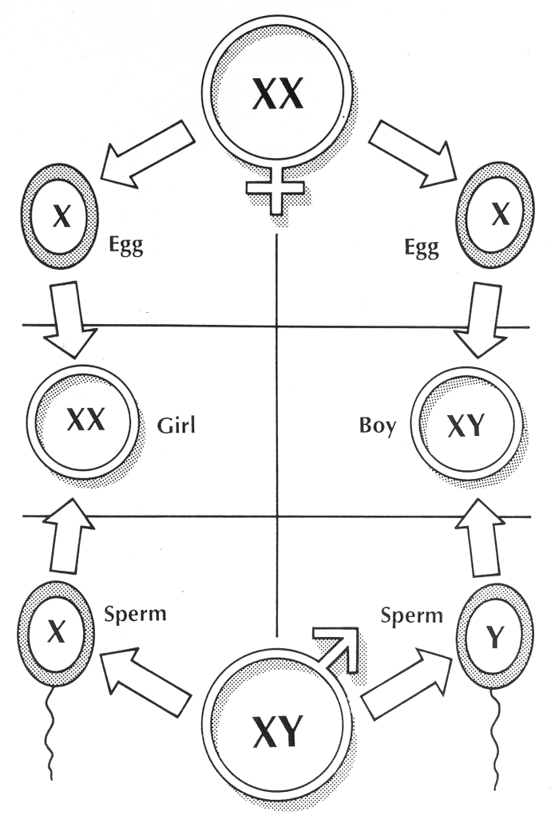
Woman’s sex cell:
Ovum/Egg
Man’s sex cell:
Sperm

Slide 6
TWINS!!!
Monozygotic:
Identical twins: Fertilized eggs splits.
Siamese Twins:
Monozygotic, but the egg does not complete the seperation of the cell- still attached somewhere.
Dizygotic:
Fraternal Twins: Two separate eggs are fertilized.

Slide 7
Factors to Increase Chances of Having Twins
History of twins in family
Taking increased amount of hormones
Use of artificial hormones
Ages 32-36 +

Slide 8
GENES
Dominant Gene
Stronger gene- characteristics is produced.
Dominant Inheritance
Dd x dd
50/50 chance of inheriting a trait
Recessive Gene:
Weaker gene- they do not produce characteristics, but are carried only to produce when both parents carry. Dd x dd
Recessive Inheritance
Rr x Rr 50% chance

Slide 9
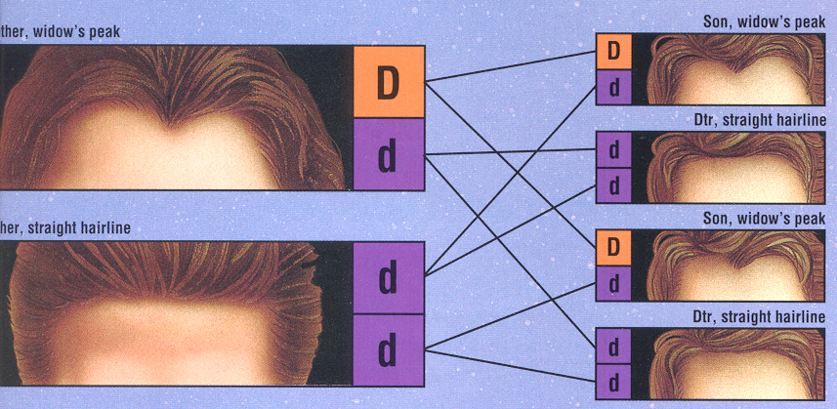

Slide 10
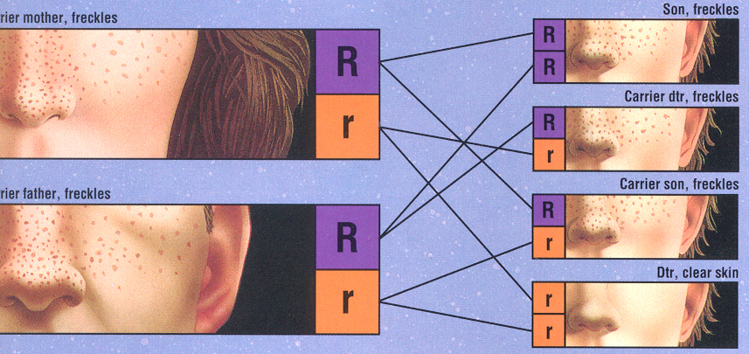

Slide 11
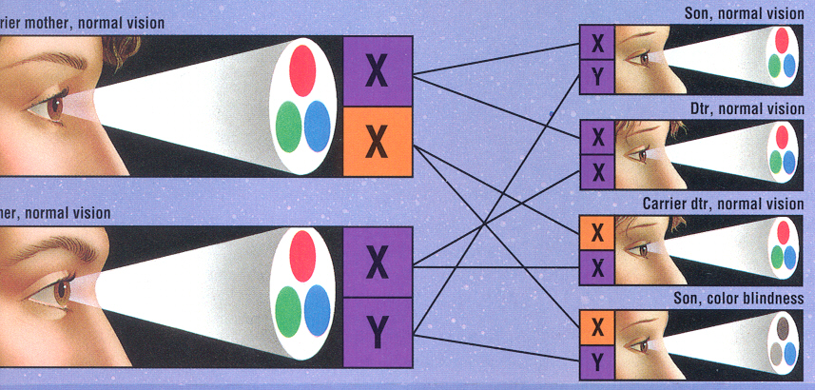

Slide 12
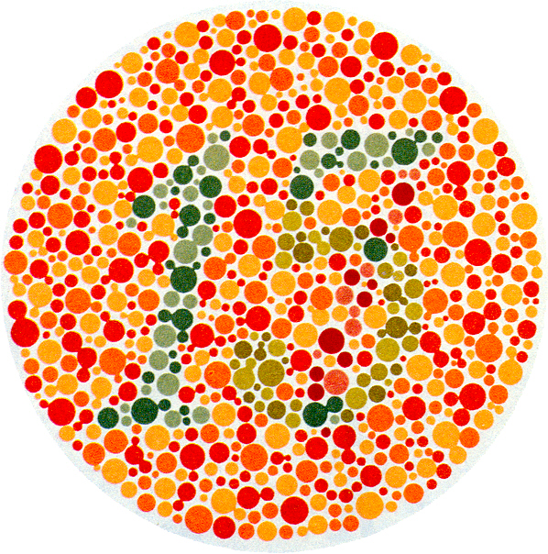

Slide 13
Terms
Syndrome:
Set of characteristics that identify a certain condition or characteristic
Carrier:
Person who carries and passes on a disease or condition without having it himself.
Congenital Malformation or Birth Defect
Defect present at birth
Multifactoral defects:
interaction of many genes with other genes or environmental factors.
Chromosomal error:
Fertilized egg cell contains chromosomes in an abnormal number, structure or arrangement.

