Slide 1
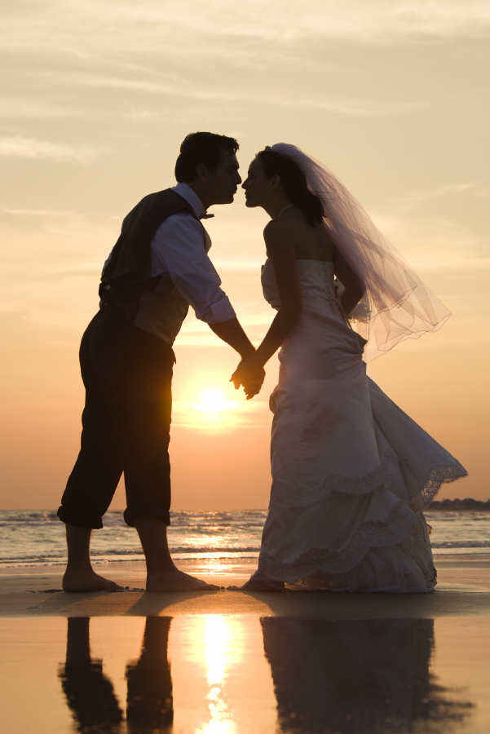
Love vs. Infatuation
Love
1. Grows Slowly
2. Long- Lasting
3. Love the entire person (inside and out)
4. want other Person To Grow
5. Willing to compromise
6. Trust
7. Ability to Wait
Infatuation
1. Happens Quickly
2. Short-Lived
3. Focused Mainly on Appearance
4. Become Jealous
5. Many Arguments
6. Insecure
7. Rush Into Marriage

Slide 2
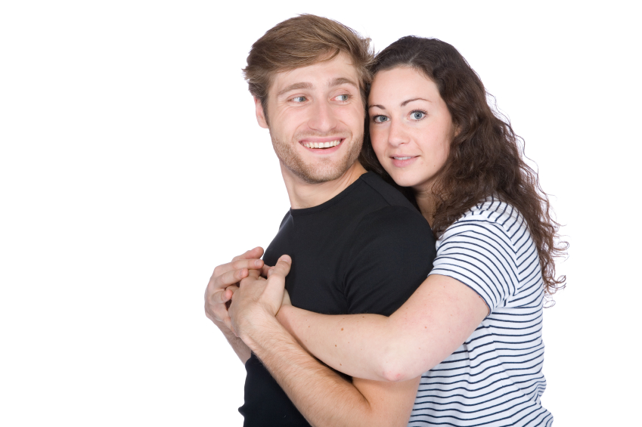
Kinds of Love

Slide 3

Romantic Love: Happy Love

Slide 4

Sexual Love: The intimate expression of love

Slide 5

Pragmatic Love: A rational reasoning of love

Slide 6
Platonic love: Spiritual and intellectual relationship

Slide 7
Companionship Love: Love felt for friendships

Slide 8
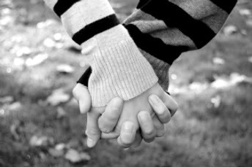
Altruistic Love: Selfless love, or concern for spouse

Slide 9

Manic Love: A crazy, possessive, jealous kind of love

Slide 10

Self-Love: An egotistic, narcissistic kind of love

Slide 11
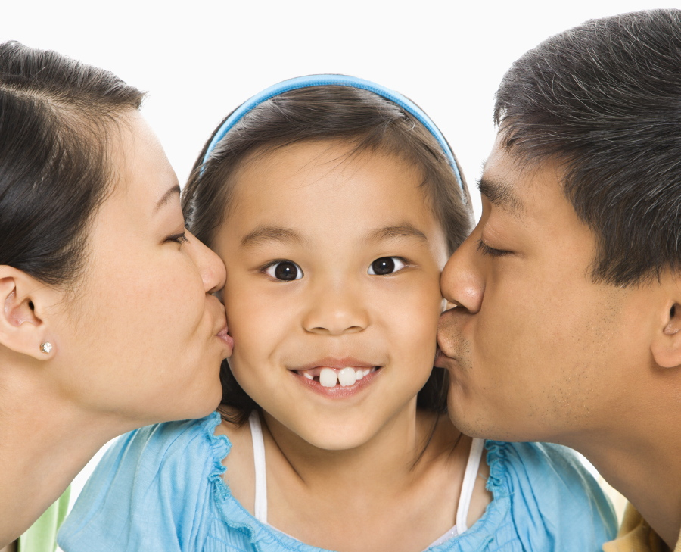
“What True Love Means To A Child”

Slide 12
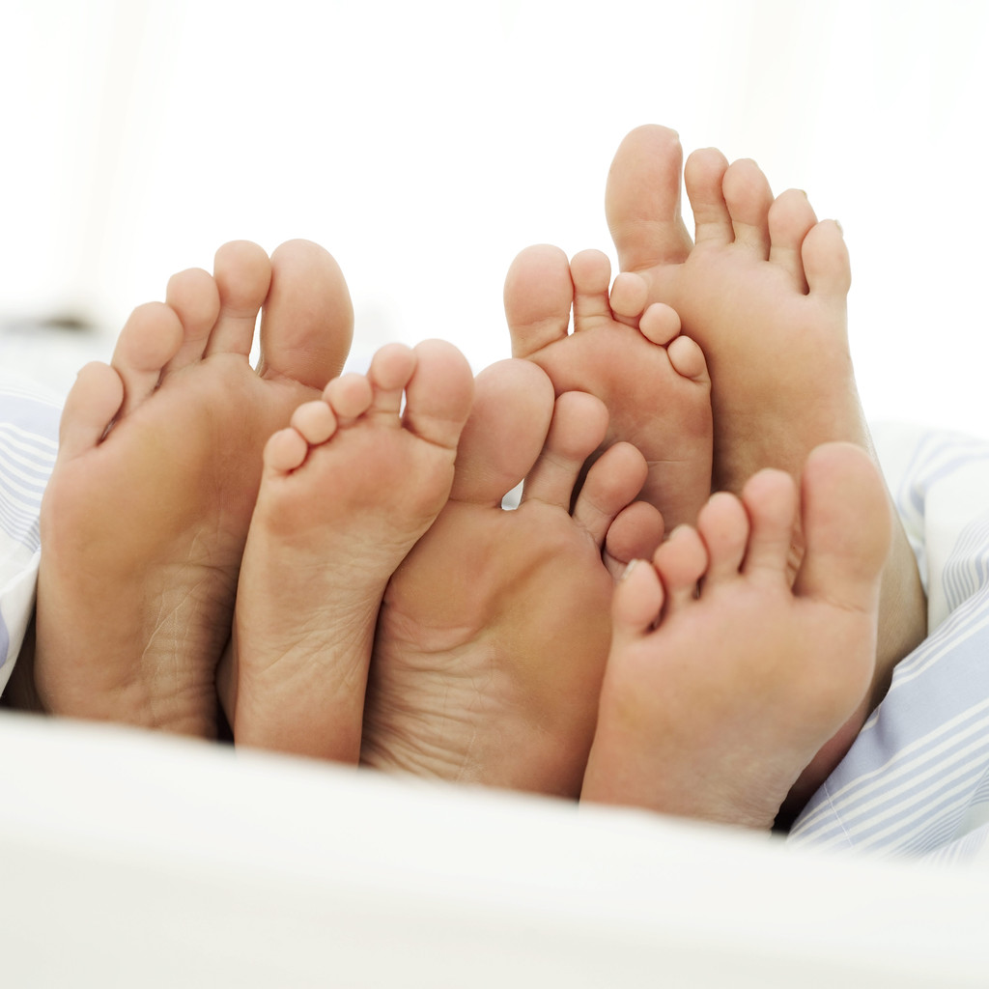
‘When my grandmother got arthritis, she couldn’t bend over and paint her toenails anymore. So my grandfather does it for her all the time, even when his hands got arthritis too. That’s love.”
Rebecca – Age 8

Slide 13
“When someone loves you, the way they say your name is different. You just know that your name is safe in their mouth. “
Billy – Age 4

Slide 14
“Love is when a girl puts on perfume and a boy puts on cologne and they go out and smell each other.”
Karl- age 5

Slide 15
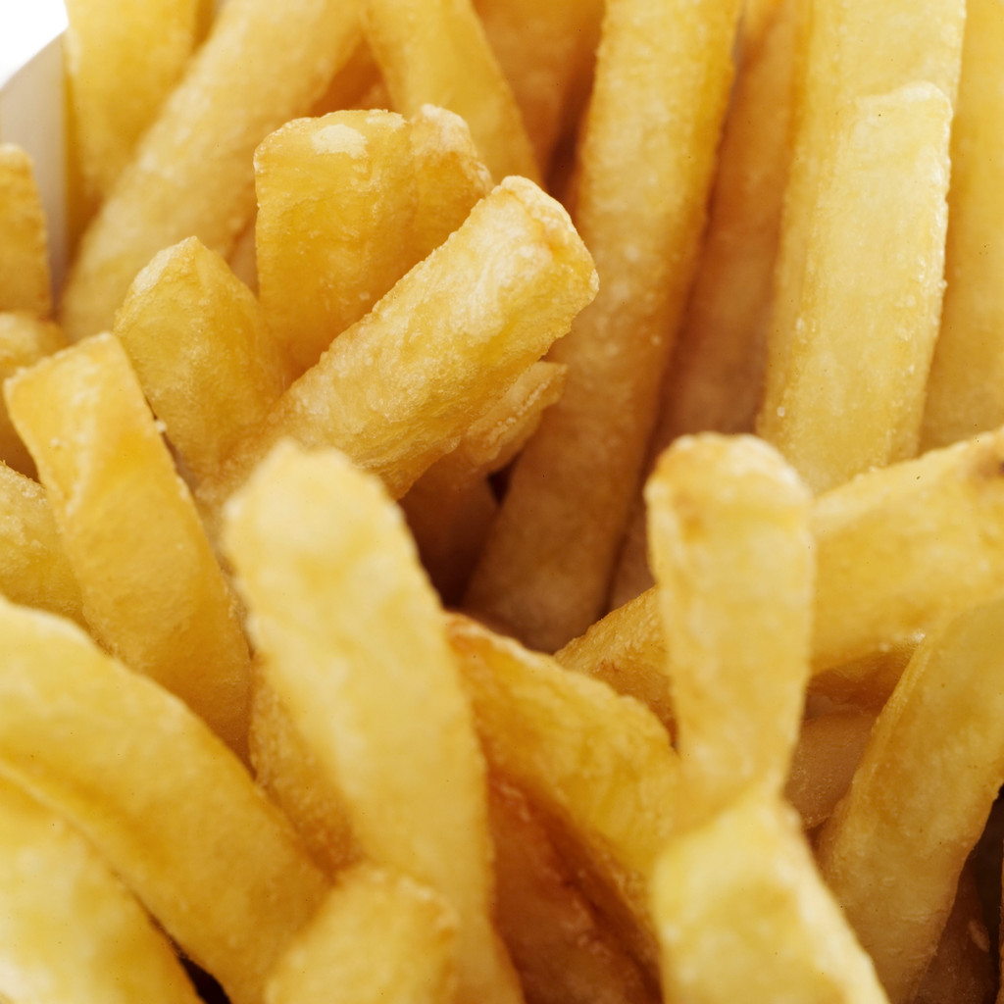
“Love is when you go out and give somebody most of your French fries without making them give you any of theirs.”
Christy- Age 6

Slide 16
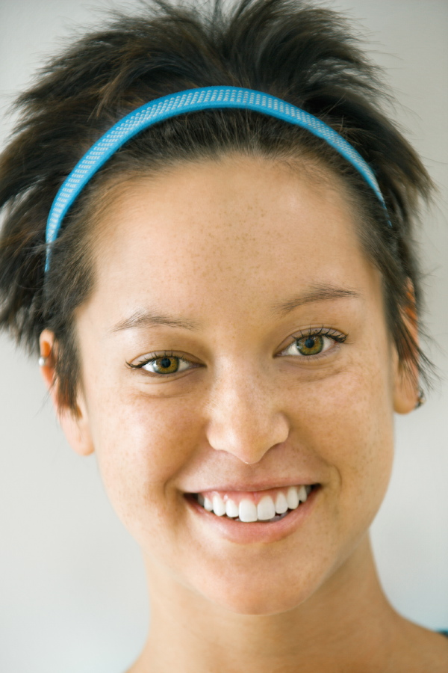
“Love is what makes you smile when your tired.”
Terri Age 4

Slide 17




“Love is when you kiss all the time. Then when you get tired of kissing, you still want to be together and you talk more. My mommy and daddy are like that. They look gross when they kiss.”
Emily- Age 8

Slide 18

“Love is what’s in the room with you at Christmas if you stop opening presents and listening.”
Bobby- age 7

Slide 19
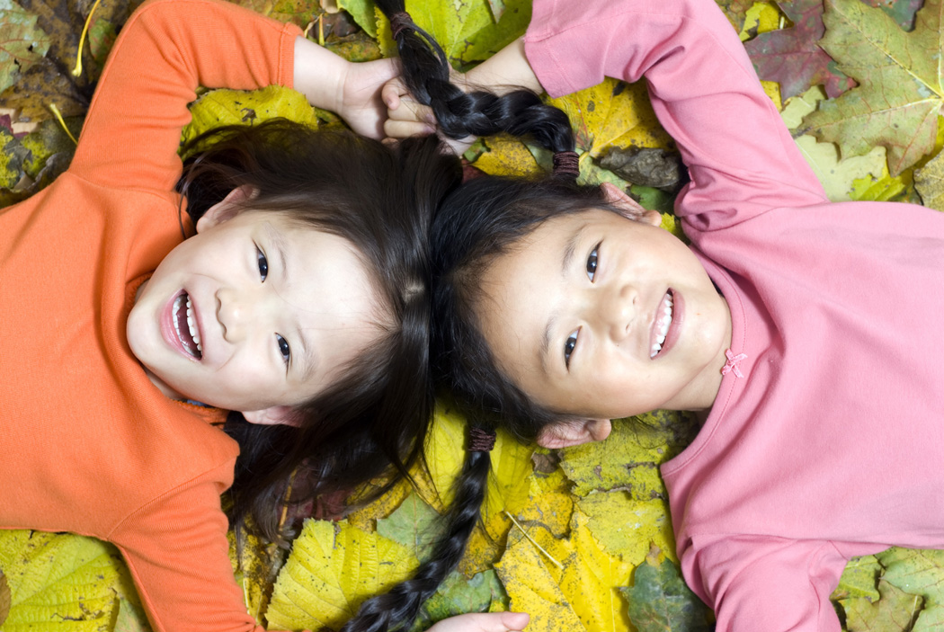
“If you want to learn to love better, you should start with a friend who you hate.”
Nikki- age 6

Slide 20

“Love is when you tell a guy you like his shirt, then he wears it everyday.”
Noelle- age 7

Slide 21

“Love is like a little old women and a little old man who are still friends even after they know each other well.”
Tommy- Age 6

Slide 22
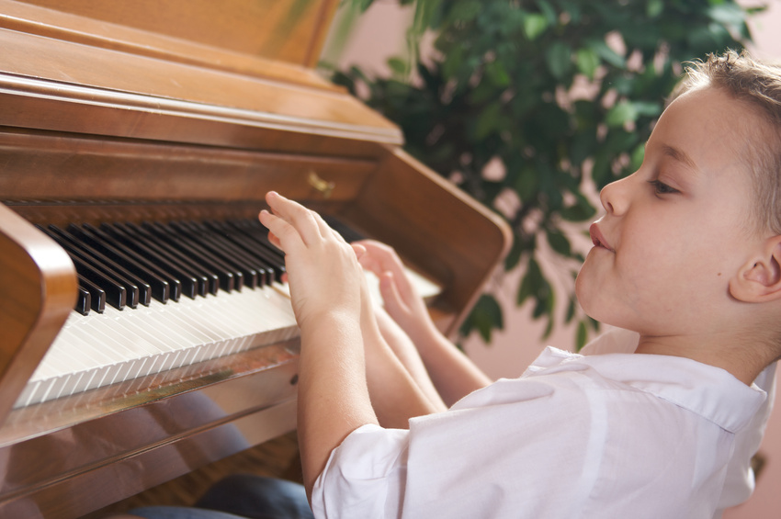
“During my piano recital, I was on stage and I was scared. I looked at all the people watching me and waving and smiling. I wasn’t scared anymore.”
Cindy- Age 8

Slide 23
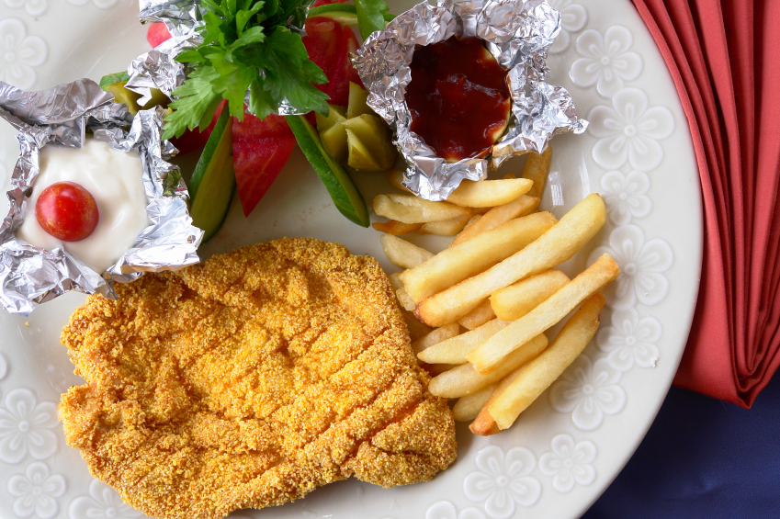
“Love is when my mommy gives my daddy the best piece of chicken.”
Elaine- age 5

Slide 24
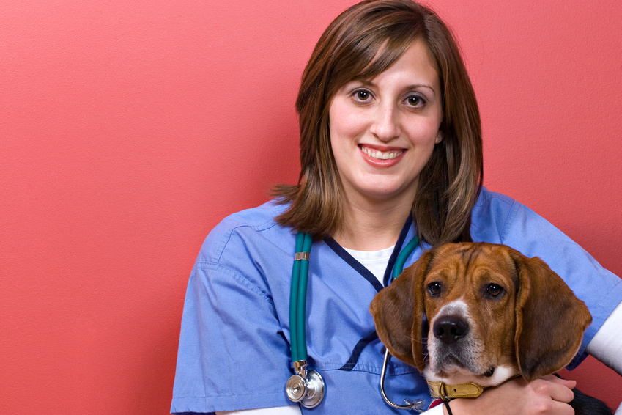
“Love is when your puppy licks your face even after you left him alone all day.”
Mary Ann- age 4

Slide 25
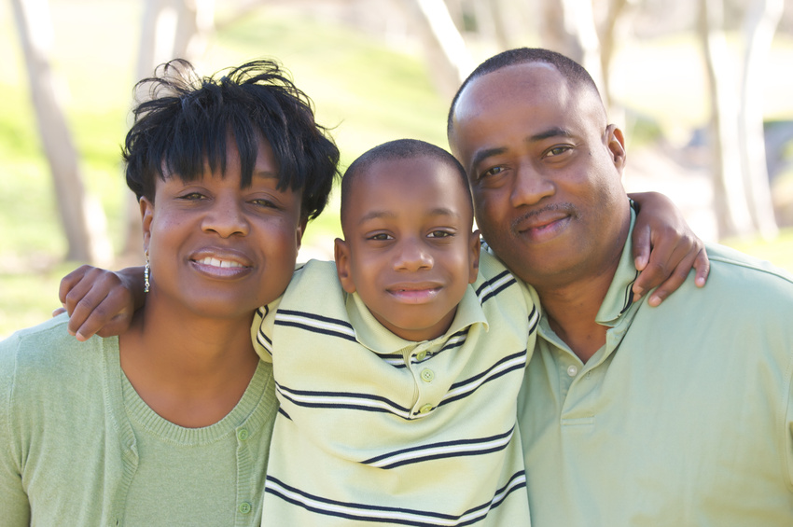
“Love is when mommy sees daddy smelly and sweaty and still says he looks handsomer than Brad Pitt.”
Chris- Age 7

