Slide 1
Safety Guidelines and Safe Work Habits

Slide 2
To avoid CUTS:
Use SHARP knives rather than dull ones.
2. Do not put knives in a DRAWER full of knives.
3. Store knives in a KNIFE BLOCK or a knife RACK.

Slide 3
4. Clean up any broken glass IMMEDIATELY; and wrap your hand in a WET PAPER TOWEL before touching the broken glass.
*If this happens in the lab, get me immediately and let me know what was broken and if anyone was hurt.

Slide 4
5. In the case of someone getting cut, the general rule is to APPLY PRESSURE by using a clean cloth covering the wound and pressing directly on the wound.
6. Sometimes, you will need to apply pressure on the wound and on the nearest PRESSURE POINT.

Slide 5
To avoid getting BURNED:
Stand to the side of the oven when OPENING it.
2. Use HOT PADS for handling hot pans etc. (this includes those coming out of the microwave).

Slide 6
3. Lift the lids off of foods so the STEAM goes AWAY FROM you.
4. Pull the RACK of the oven OUT rather than having to reach in.
5. In the case of a burn you will need to determine the SERIOUSNESS of the burn.

Slide 7
• If it is a FIRST degree burn, it will be red, but there will not be any blisters. In this case, you should run it under COLD WATER.

Slide 8
• If it is a SECOND degree burn, it will have blisters and be red. In this case, you can cover with a COOL CLOTH, or have a doctor check it if it is a large area.

Slide 9
• If it is a THIRD degree burn, the skin will be discolored or MELTED AWAY. In this instance, you should determine how large of an area is burnt, then call for HELP. Avoid touching the burnt area and lightly cover the area with a cool cloth.

Slide 10
To help prevent FIRES:
Keep all FLAMMABLE OBJECTS away from direct heat.
2. Never put PAPER TOWELS on the range.
3. Watch your STOVE carefully.
4. In case of a fire, you need to treat it according to the FIRE REGULATIONS.

Slide 11
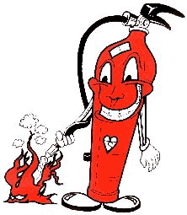
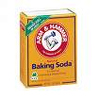
If it is a grease fire:
Put a LID on it
Pour BAKING SODA on it
Use a fire EXTINGUISHER

Slide 12
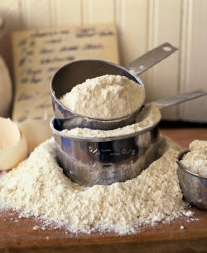
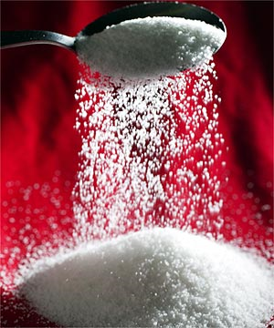
Do NOT ever use:
Water
Sugar
Flour

Slide 13
Cleaning and the supplies that you use to clean are a very important part of a safe work environment. (It also helps to prevent an invasion of insects and rodents….GROSS!)

Slide 14
You should keep all SURFACES and EQUIPMENT clean.
2. Wash the counter with a DISINFECTANT before you begin to cook.
3. Clean AS YOU GO. It will keep the area clean and will make the clean-up much easier.

Slide 15
4. To properly wash dishes:
a. Throw away or rinse any food left on dishes
b. Fill one sink with hot soapy water
c. Fill the other sink with plain hot water
d. Wash dishes in soapy water, then rinse all soap away in the plain hot water
e. Place dishes in dish rack or dry with a clean towel

Slide 16
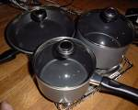
5. When you are doing the final clean-up, you should wash the dishes in the following order:
a. Glassware
b. Silverware/Flatware
c. Dishware
d. Kitchen Tools
e. Pots and Pans

Slide 17
Food Borne Illnesses and Prevention Tips
Food borne illnesses result from eating contaminated foods
Bacteria grows with TIME, FOOD, MOISTURE and WARMTH
Do not buy bulging cans
Frequently clean and sanitize hands and work surfaces
WHEN IN DOUBT, THROW IT OUT!

Slide 18
Food Borne Illnesses
Salmonella- Chicken, poultry, eggs
E-Coli- Ground beef
Botulism- Improperly canned foods
Hepatitis A- Not washing hands (fecal matter)
Campylobacter- unpasteurized dairy products
Staphylococcus (Staph)- Human mucous

Slide 19
Storing and Thawing Foods
Foods should be COLDER than 41* or HOTTER than 135*
Raw meat, poultry and seafood should be in sealed containers away from fresh foods
Thaw in fridge, under cool running water or in microwave if cooking immediately. NEVER thaw at room temperature

Slide 20
Temperatures
Danger zone: 41-135*
Internal meat temperatures
Seafood, whole pork veal or lamb: 145*
All ground meats: 155*
All poultry and reheating leftovers: 165*

Slide 21
Terms to Remember
Cross-contamination: Spreading bacteria from one surface to another
How to prevent?
FIFO: First in, first out
Mise en place: Every thing has it’s place and every place has it’s thing
Temperature Danger Zone: Where bacteria is most likely to grow 41-135*F

